Slide 1

4. Research Design
Frank (Yufan) Lin

Slide 2
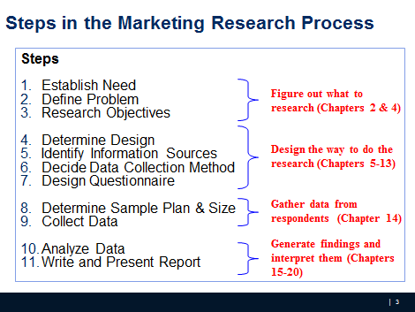
Where we are

Slide 3
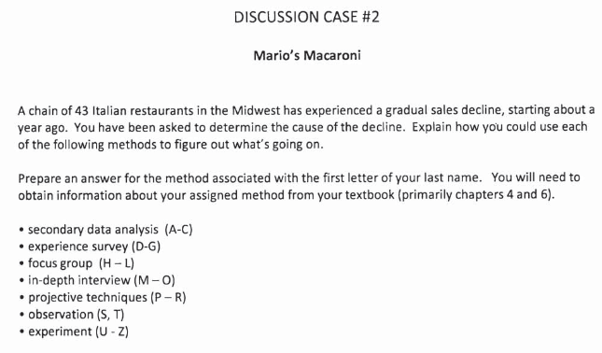
CE 2
iCliker - write your answer in 2-3 sentences on iClicker
Notes:
What could be the potential causes that a restaurant is having a gradual sales decline? pick a specific method and consider the probable cause.

Slide 4

Research Design
Research design is a set of advance decisions that make up the master plan specifying the methods and procedures for collecting and analyzing the needed information.
‹#›

Slide 5

Types of Research Design
The choice of the most appropriate design depends largely on the objectives of the research and how much is known about the problem.
‹#›

Slide 6
Types of Research Design
Three traditional categories/methods:
Exploratory
Descriptive
Causal
‹#›

Slide 7
Exploratory Research
Exploratory research is most commonly
unstructured, informal research that is
undertaken to gain background Information about
the general nature of the research problem.
By unstructured, we mean there is no formal set
of objectives, sample plan, or questionnaire.
‹#›

Slide 8
Exploratory Research (qualitative research)
Research Objective | Appropriate Design
To gain background information, to define terms, to clarify problems and hypotheses, to establish research priorities | Exploratory
Many questions; many sources
Defining the problem; getting a “feel”
Goal:generate ideas (e.g., what, why) for descriptive and exploratory research (quantitative research). See example.
Uses
Gain Background Information
What is a bank image study?
Define Terms
What terms are used?
Clarify Problems and Hypothesis
What type of bank customers? Retail? Commercial? Correspondent Banks?
Establish Research Priorities
‹#›
Notes:
RQ: What criteria do household use when selection department store. Why do they do so?
See the talking points with client.

Slide 9
Research Design: Exploratory Research
A variety of methods are available to
conduct exploratory research
Ethnography: Living the experience, observation without interference
Case Analysis
Focus Groups: Talk to people to get their opinion
Secondary data analysis
Others (Depth Interview, protocol analysis, projective techniques
‹#›

Slide 10
Focus Groups
Focus groups are small groups of people brought
together and guided by a moderator through an
unstructured, spontaneous discussion for the purpose of
gaining information relevant to the research problem.

Slide 11
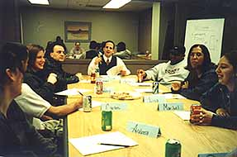

Types of Focus Groups
Traditional: Select 6 to 12 people and meet in a dedicated room with one-way mirror for client viewing, for about two hours.
Nontraditional: Online with 25-50 respondents, allow clients to participate

Slide 12
Pros and Cons of Focus Groups
Pros:
Generate fresh ideas
Allow clients to observe their participants
May be directed at understanding a wide variety of issues
Allow fairly easy access to special respondent groups
Cons:
Representativeness of participants
Interpretation sometimes difficult
High cost per participant
Cannot be used for prediction

Slide 13
Interview guide (for meeting with the client):
1. What is the product/service being provided?
2. What is special 'unique about the product/service?
3. Does the client know who their competition is?
4. Is there a special group of people (such as college students) that the product/service is meant for? Are there different groups of people that the client thinks uses their product/service?
5. Does the client think the different groups think of their product/service differently?
6. What information does the client hope to get from this project? Do they want this information?
7. What are the different things that the client wants to know? Prioritize these questions.
8. Wmat decisions will the client make using the information above? There should be several alternatives that you should get from the client for this decision- e.g. where to advertise their product is the decision that will be aided by your project. The decision alternatives would be advertise in Add Sheet, Columbia Tribune, Missourian, Radio, Television etc
Notes:
(Point 1- 3 for identifying the problem and causes, point 4-5: target customers and difference type RQ, point 6-7: info needs to form your research objections and their prioritization, point 8: decision alternatives).

Slide 14
Descriptive Research
Descriptive research is undertaken to describe answers to questions of who, what, where, when, and how.
Descriptive research is desirable when we wish to project a study’s findings to a larger population, if the study’s sample is representative
‹#›

Slide 15
Descriptive Research
Research Objective | Appropriate Design
To describe and measure marketing phenomena at a point in time | Descriptive
Goal:quantify the responses (e.g., how much?What percent?)
Example: questionnaire/ survey
Uses
Measure performance
How is the bank doing in terms of customer satisfaction?
Assess market related phenomena
Why people prefer brand X over Y
‹#›

Slide 16
Vague research question for survey research
CE1 discussion.

Slide 17
Research Design: Descriptive Research
Two basic classifications:
Cross-sectional: measure units from a sample of the population at only one point in time. E.g., Survey
Longitudinal: repeatedly measure the sample over time. E.g., Panels (continuous vs. discontinuous)
‹#›

Slide 18
Marketing Research Panels
Continuous panels ask panel members the same
questions on each panel measurement. Uses – Brand
tracking studies, measure change in consumer attitude,
behavior etc.
Discontinuous panels also known as Omnibus vary
questions from one panel measurement to the next. Uses – provide a very broad sample
‹#›

Slide 19
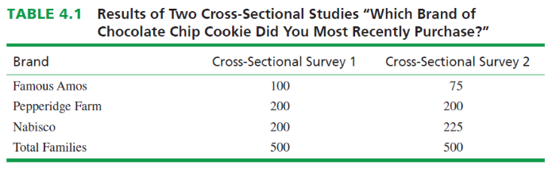
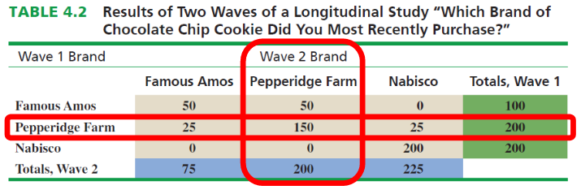
Marketing Research Panels - Breakout room: does Pepperidge Farm need to worry about its competitors?
‹#›
Notes:
iCliker poll what’s differenece?

Slide 20
Causal Research
Causality may be thought of as understanding
a phenomenon in terms of conditional statements
of the form “If x, then y.”
X🡪 Y
Causal studies are conducted through the use of
experiments.
‹#›

Slide 21
Causal Research
Research Objective | Appropriate Design
To determine causality, to make “if- then” statements | Causal
Uses
To find causes
What makes movies like “The Dark Knight Rises” appeal to masses
Does background music affects purchase behavior
‹#›

Slide 22
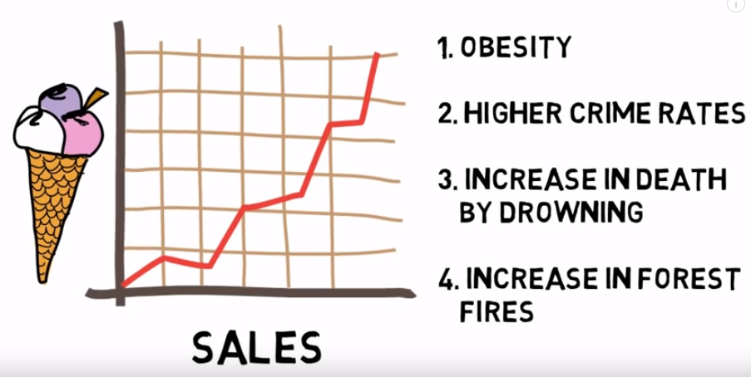
Causality – or is it really?
‹#›
Notes:
Video from pepsi challenge

Slide 23
Research Design: Causal Research
An experiment is defined as manipulating an independent variable to see how it affects a dependent variable, while also controlling the effects of additional extraneous variables.
Two Types of Experiments
Laboratory Experiment
In-Field Experiment
‹#›

Slide 24
Example of Causal Research: Test Marketing
Test marketing is the phrase commonly used to indicate
an experiment, study, or test that is conducted in a field
setting.
Uses of test markets
To test sales potential for a new product or service
To test variations in the marketing mix for a product or service
‹#›

Slide 25
Independent Variable
Independent variables are those variables which the researcher has control over and wishes to manipulate.
E.g., level of ad expenditure; type of ad appeal; price; product features, etc.
‹#›

Slide 26
Dependent Variable
Dependent variables are those variables that we have little or no direct control over, yet we have a strong interest in. E.g., return on investment (ROI), net profits, market share, customer satisfaction.
‹#›

Slide 27
Extraneous Variables
Extraneous variables (control variables) are those
variables that may have some effect on a dependent
variable yet are not independent variables. Extraneous
variables must be controlled through proper
experimental design.
‹#›

Slide 28
Experimental Design
Experimental design is a procedure for devising an experimental setting such that a change in a dependent variable may be attributed solely to the change in an independent variable.
iClicker: how would you design an experiment to assess if the ‘buy one get one free’ on shoes promotion increases the sale during Christmas?
‹#›

Slide 29
Experimental Design
Experimental group (R) O1 X O2
Where Effect: (O2 - O1)
‹#›

Slide 30
Experimental Design
Experimental group (R) O1 X O2 Control group (R) O3 O4
Where E: (O2 - O1) - (O4-O3)
‹#›

Slide 31
Pretest and Posttest
Pretest refers to the measurement of the dependent
variable taken prior to changing the independent
Variable (IV)
Posttest refers to the measurement of the dependent
variable after changing the independent variable (IV)
‹#›

Slide 32
Pretest and Posttest
Internal Validity: the extent to which the researcher is certain that a change in a dependent variable is actually due to the independent variable
External validity is taken care of if the test and control groups are representative
‹#›

Slide 33
Recap – iclicker poll
Research Design:
Master plan of how to go about collecting and analyzing information
Types of Research Design:
Exploratory
Descriptive
Causal
Examples??
‹#›
Notes:
There are basic marketing research designs that can be successfully matched to given problems and research objectives, and they serve the researcher much like the blueprint serves the builder.

Slide 34
What’s coming?
Answer to vague RQ in CE1
Discussion case #3
PA3

